Slide 1
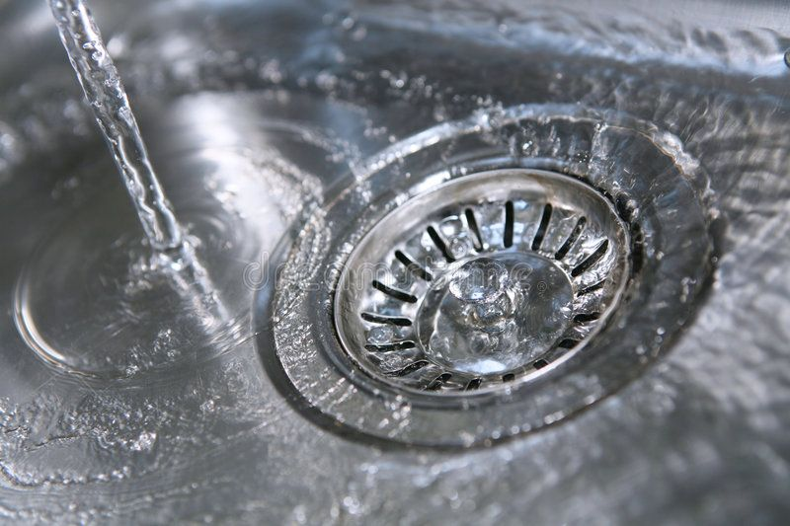
GRADIENT,DIVERGENCE AND CURL
NAZMUL KADER CHOWDHURY

Slide 2
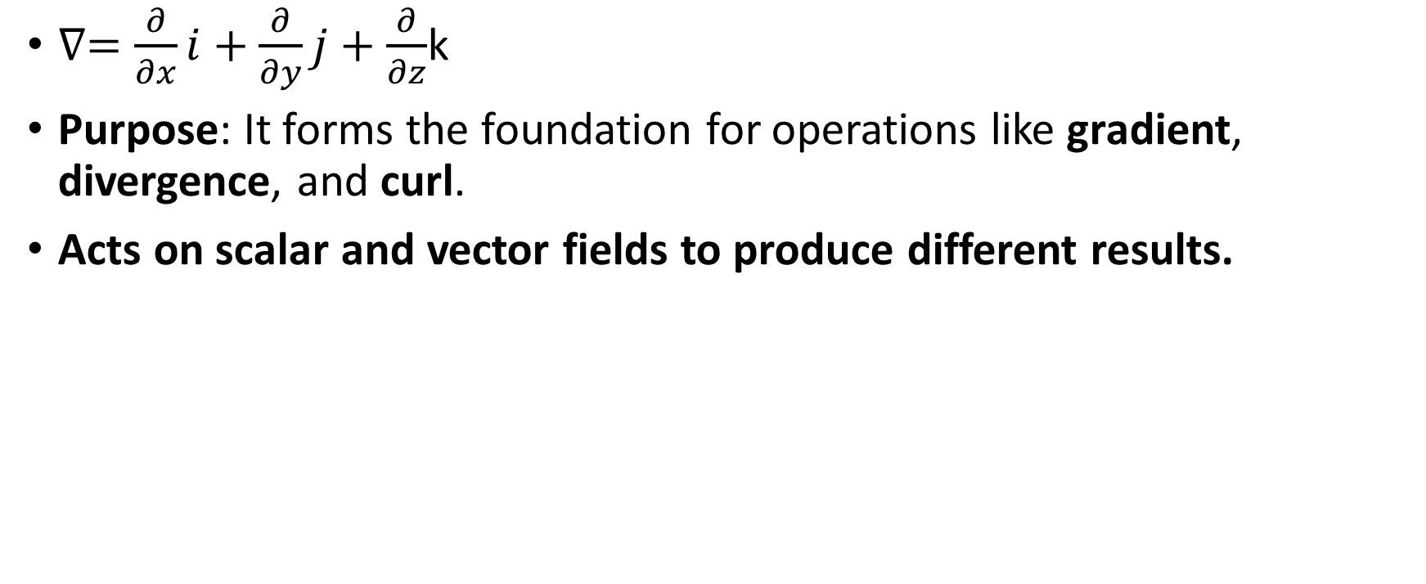
DIFFERENTIAL OPERATOR DEL
$∇=\frac{∂}{∂x}i+\frac{∂}{∂y}j+\frac{∂}{∂z}$k
Purpose: It forms the foundation for operations like gradient, divergence, and curl.
Acts on scalar and vector fields to produce different results.

Slide 3
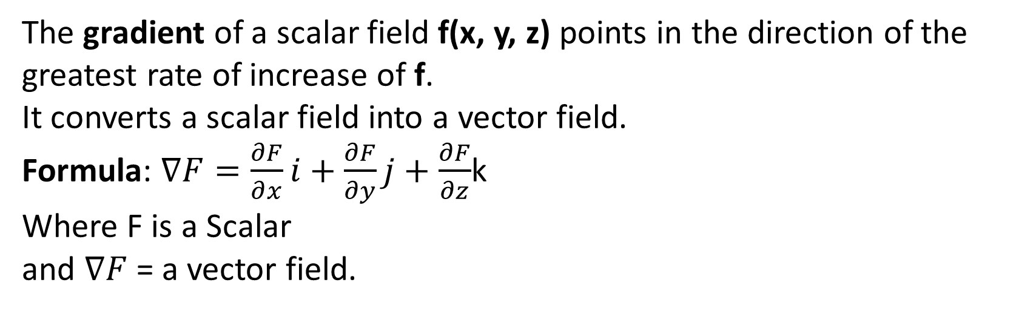
Gradient
The gradient of a scalar field f(x, y, z) points in the direction of the greatest rate of increase of f.
It converts a scalar field into a vector field.
Formula: $∇F=\frac{∂F}{∂x}i+\frac{∂F}{∂y}j+\frac{∂F}{∂z}$k
Where F is a Scalar
and $∇F$ = a vector field.
Scalar
Gradient
Vector

Slide 4
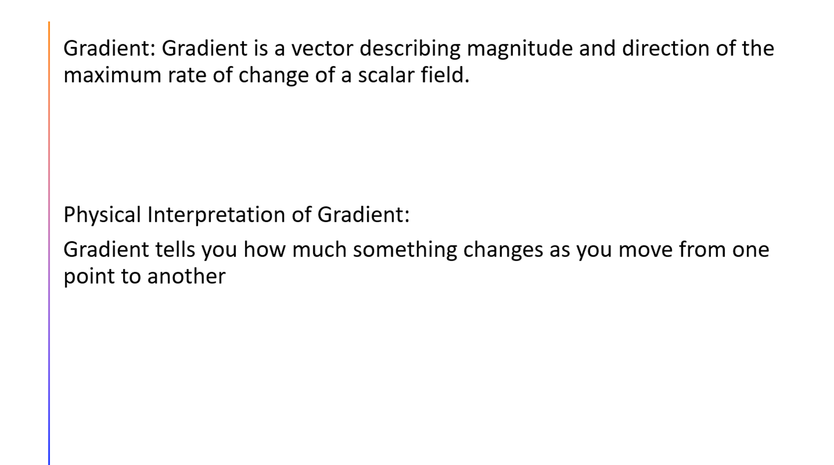

Slide 5
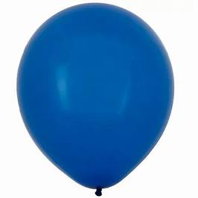
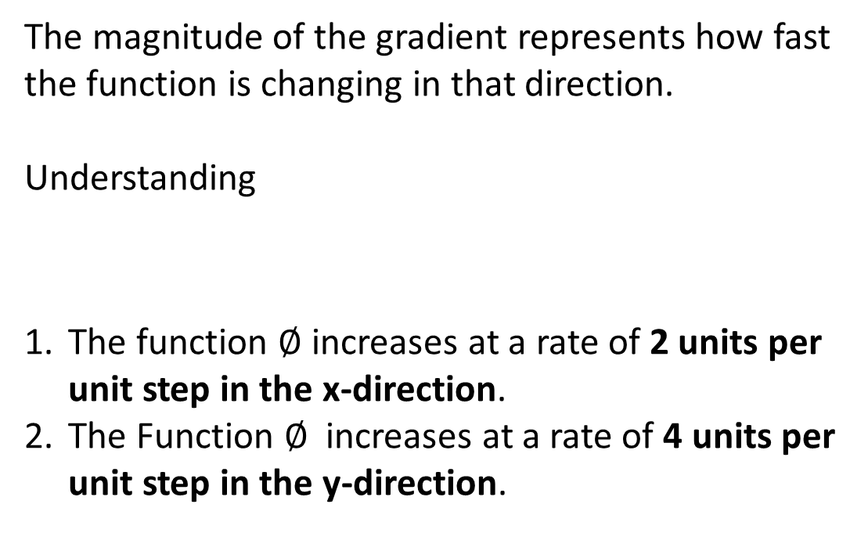
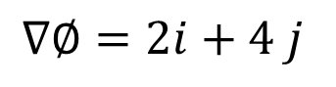
Example of gradient and its physical significance
The magnitude of the gradient represents how fast the function is changing in that direction.
Understanding
The function $∅$ increases at a rate of 2 units per unit step in the x-direction.
The Function $∅$ increases at a rate of 4 units per unit step in the y-direction.
$$∇∅=2i+4 j$$

Slide 6
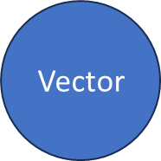
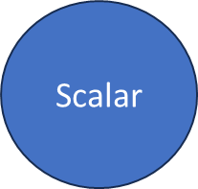

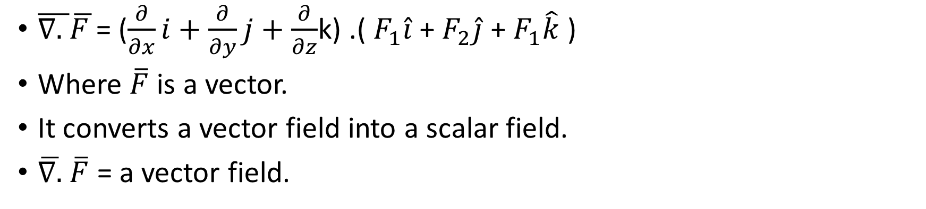
Divergence
$\overline{∇. }\overline{F }$= ($\frac{∂}{∂x}i+\frac{∂}{∂y}j+\frac{∂}{∂z}$k) .( $F_{1}\hat{i}$ + $F_{2}\hat{j}$ + $F_{1}\hat{k}$ )
Where $\overline{F}$is a vector.
It converts a vector field into a scalar field.
$\overline{∇.}$ $\overline{F}$ = a vector field.
Divergence

Slide 7
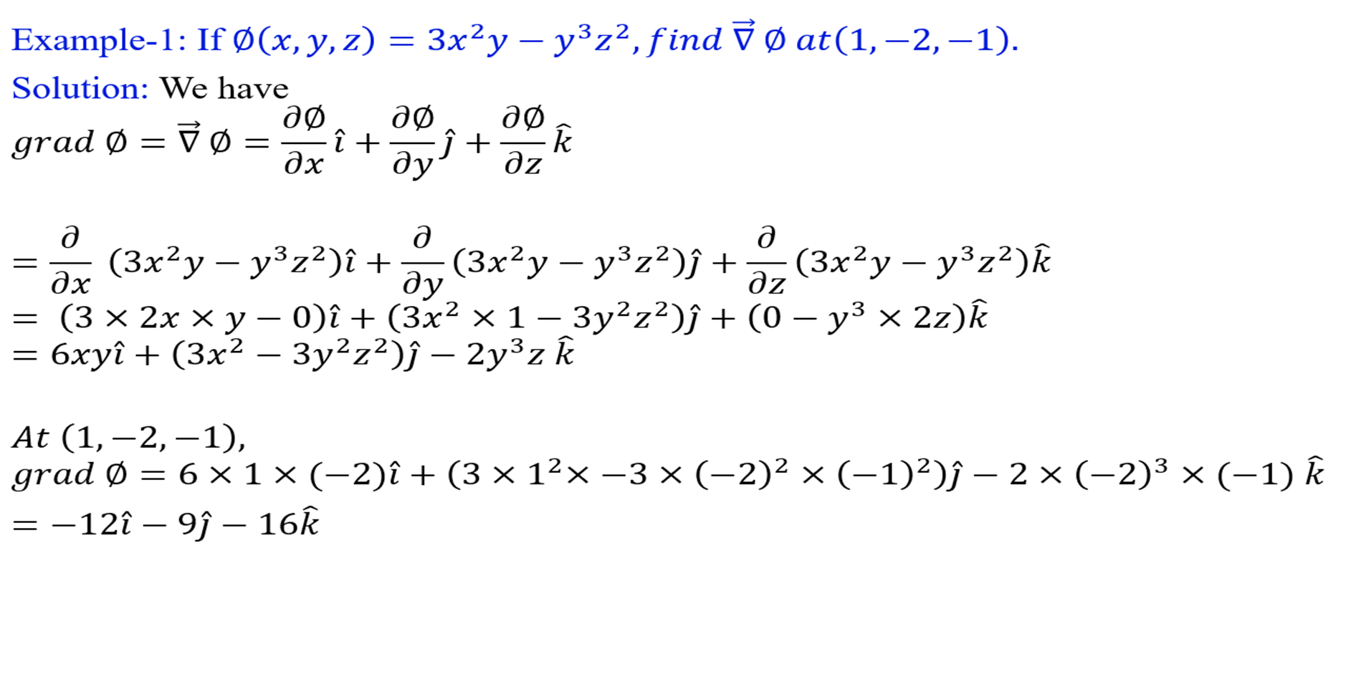

Slide 8
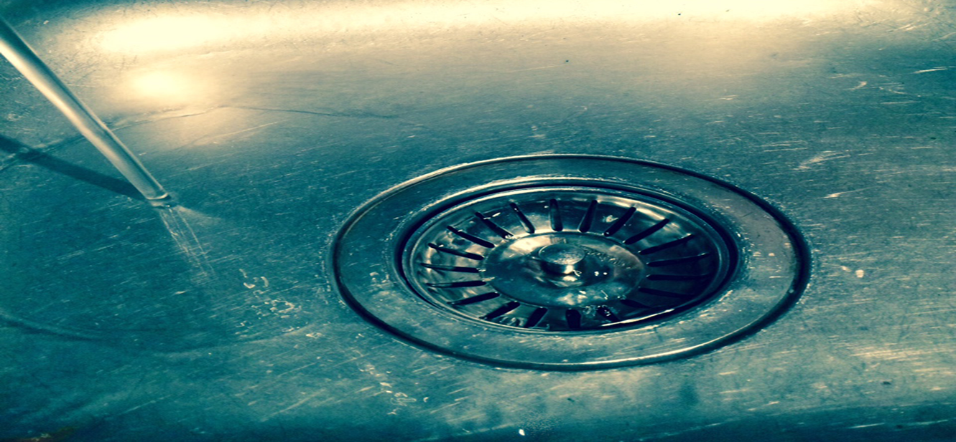
If ∇⋅F>0, more fluid is leaving a region than entering → Source (Expansion).
If ∇⋅F<0, more fluid is entering than leaving → Sink (Compression).
If ∇⋅F=0, the field is solenoidal.

Slide 9
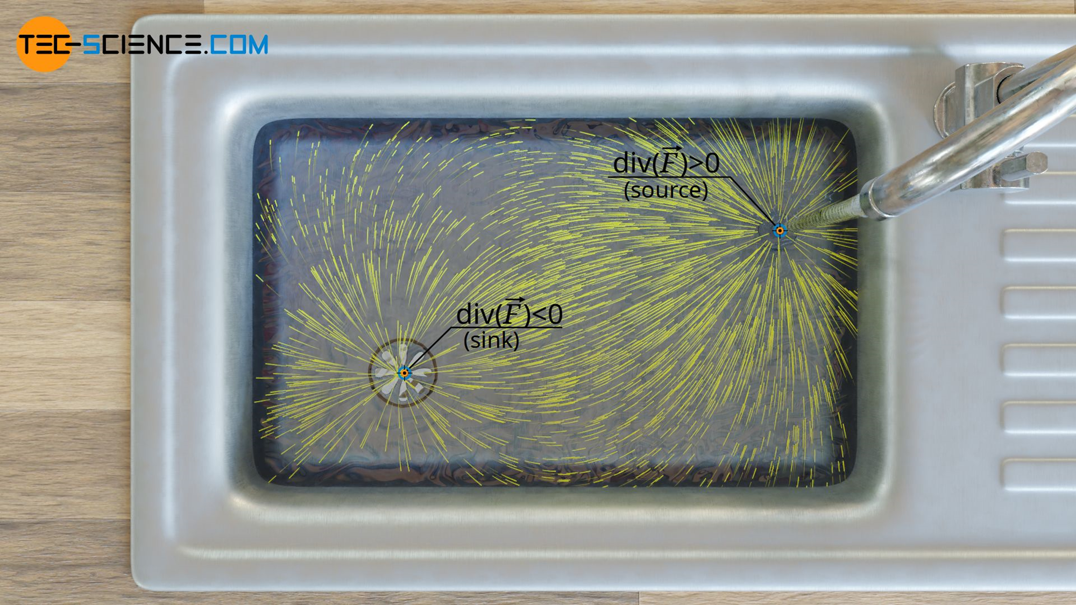

Slide 10
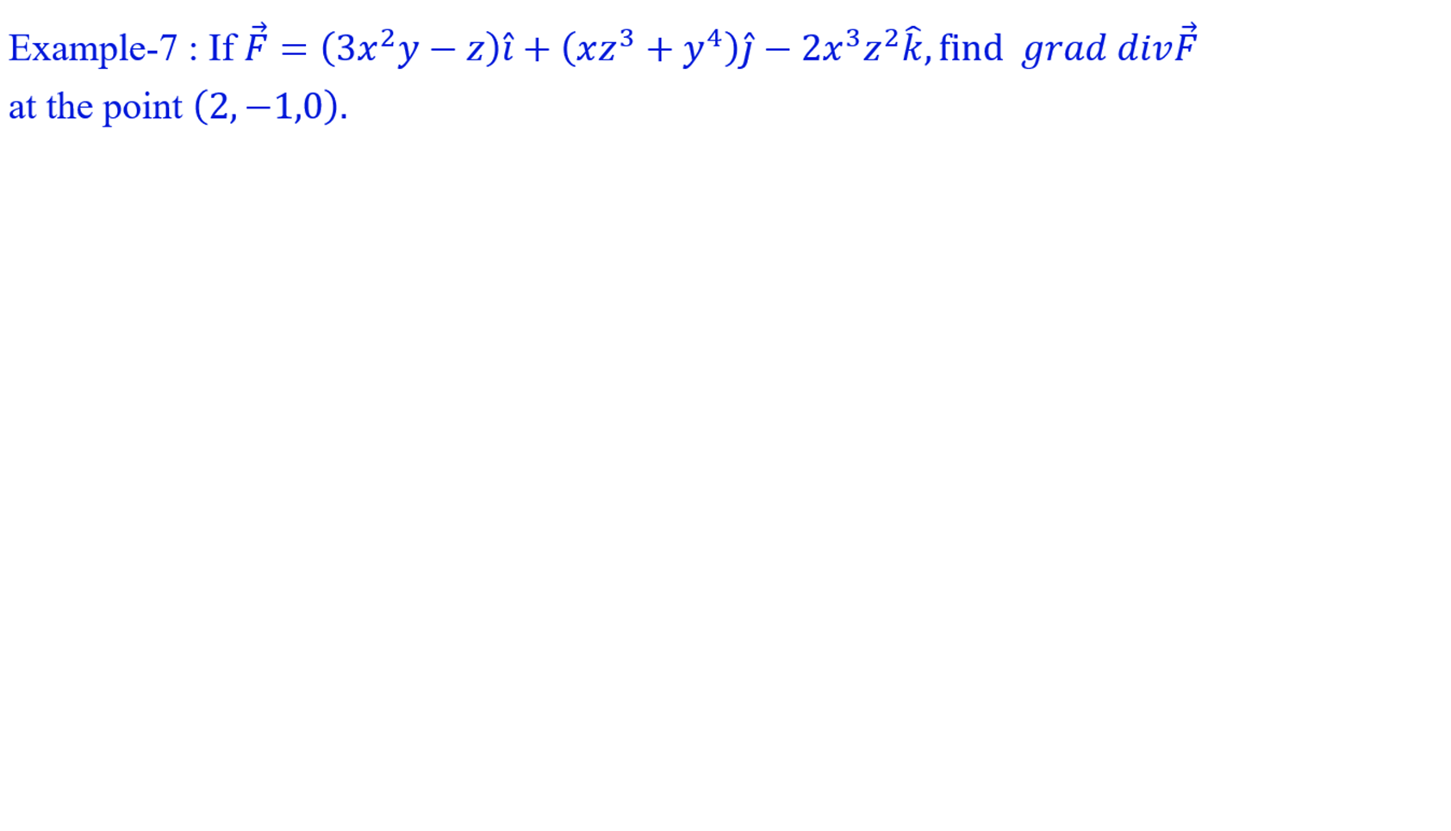

Slide 11
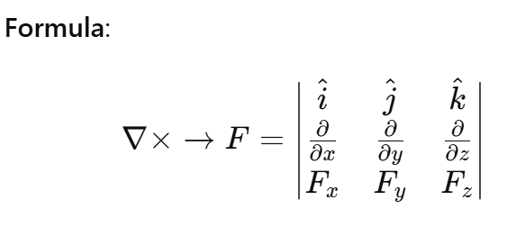
CURL
Definition: The curl of a vector field F measures the rotation or circulation of the field.
Vecrtor
CURL

Slide 12
Physical significance of CURL
If curl = 0, the field has no rotation (This means no rotational component) and conservative (irrotational).
If curl ≠ 0, the field has some circulation or rotation.
If curl > 0, Field rotates counterclockwise.
If curl< 0,s Field rotates clockwise

Slide 13
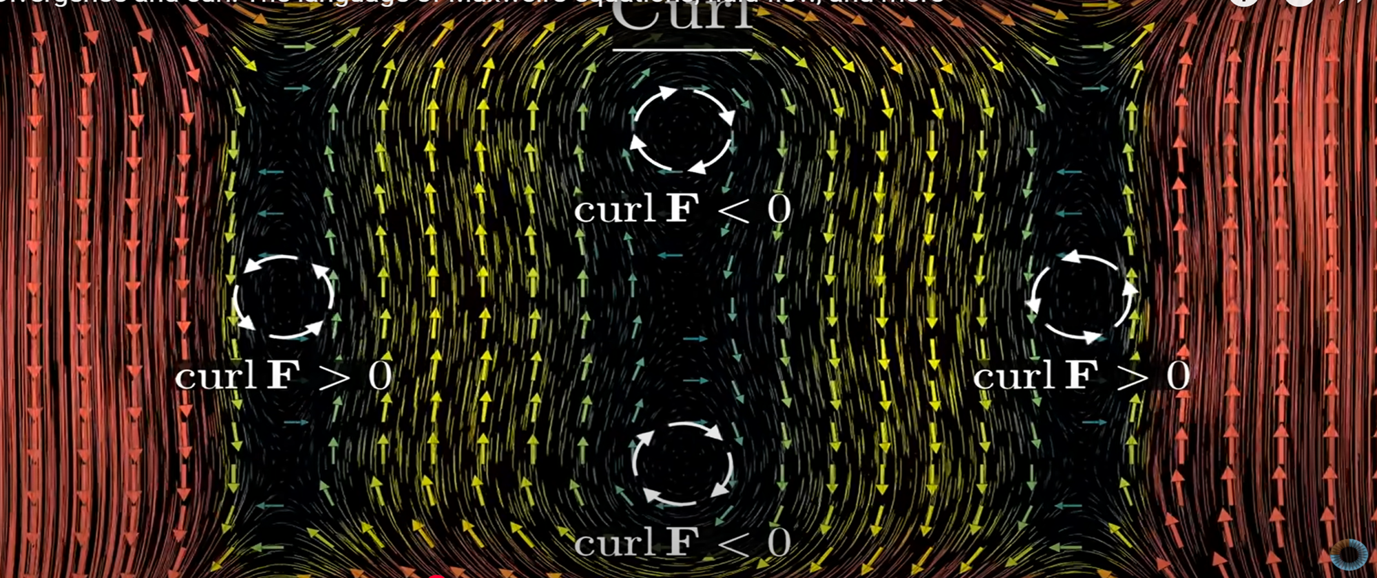

Slide 14
Thank You

